Slide 1

CLOUD COMPUTING
Presented by :UMAR ALI

Slide 2
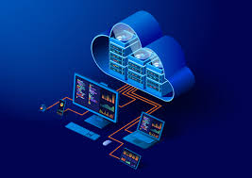
CLOUD COMPUTING
Cloud computing is the on-demand availability of computer system resources, example, (GOOGLE PHOTOS) (DRIVE) (PRIME VIDEOS) these kind of all services are based on cloud computing.
In simple term, Cloud computing means Storing, Managing , and accessing the data on internet instead of computer hard drives.

Slide 3
TYPES OF CLOUD COMPUTING
PRIVATE
PUBLIC
HYBRID
COMMUNITY

Slide 4
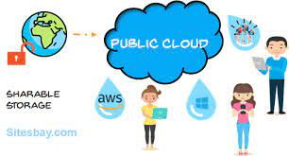
Public cloud
The cloud infrastructure is made available to general public or a large industry group and is owned by an organization selling cloud service.
Public cloud is defined as computing services offered by third-party provider over the public internet, making them available to anyone who wants to use purchase them.

Slide 5
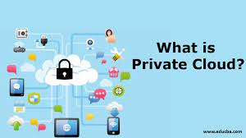
Private cloud
Private cloud is a cloud computing environment in which all hardware and software resources are dedicated exclusively to, and accessible only by, a single customer.
The cloud infrastructure is operated solely for an organization

Slide 6
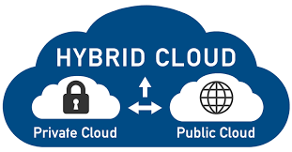
Hybrid cloud
A Hybrid cloud is a cloud computing environment that combines a private cloud with public cloud, allowing data and application to be shred between them.
The cloud infrastructure is composition of two cloud (private ,public ).

Slide 7
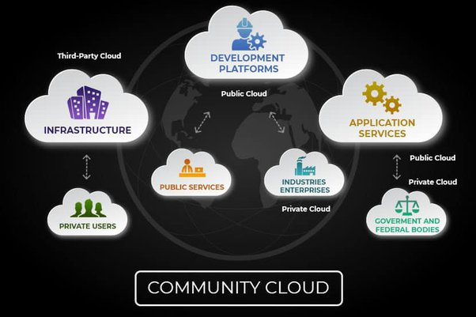
Community cloud
A community cloud in computing is a collaboration effort in which infrastructure is shared between several organization from a specific community with common concerns.
Community cloud is a cloud infrastructure that allows system s and services to be accessible by a group of several organization to share the information.

Slide 8
DISADVANTAGES OF CLOUD COMPUTING
Required a constant internet connection.
Does not work well with low speed.
Feature might be limited.
Can be slow.
Stored data can be lost.
Stored data might not be secured.

Slide 9
Thank you

